Slide 1

Modern Workplace
Carlsberg Journey with Office 365

Slide 2
The world has changed
In 2015 millennials became the largest demographic in the global workforce, and mobile browsing became the most common way to access the Internet.
Notes:
Sources:
http://www.pewresearch.org/fact-tank/2015/05/11/millennials-surpass-gen-xers-as-the-largest-generation-in-u-s-labor-force/
http://www.statista.com/statistics/284202/mobile-phone-internet-user-penetration-worldwide/
Further reading:
http://www2.deloitte.com/us/en/pages/human-capital/articles/introduction-human-capital-trends.html
https://s3.amazonaws.com/elitedaily-public/2015_EliteDaily_MillennialSurvey-2.pdf

Slide 3
You cannot fight change
Creative disruption has decreased life-expectancy of Fortune 500 companies from 75 years to 15 years, and it’s still going down.
Notes:
Sources:
http://www.aei.org/publication/fortune-500-firms-in-1955-vs-2014-89-are-gone-and-were-all-better-off-because-of-that-dynamic-creative-destruction/
Company life expectancy: Steve Denning, Forbes, via Richard Foster, Deloitte Center for the Edge - http://www.forbes.com/sites/stevedenning/2011/11/19/peggy-noonan-on-steve-jobs-and-why-big-companies-die/
Further reading:
Jack Welch quote: http://www.ceotoceo.com/jack-welch-got-it-righteven-for-customers/

Slide 4
You need to embrace it
80% of organizations have started re-organizing in reaction to this, and engaged organizations outperform competition by 147%.
Notes:
Sources:
https://www2.deloitte.com/content/dam/Deloitte/global/Documents/HumanCapital/gx-dup-global-human-capital-trends-2016.pdf
http://www.gallup.com/businessjournal/163130/employee-engagement-drives-growth.aspx
Further reading:
https://hbr.org/2015/06/what-makes-an-organization-networked
http://cw.iabc.com/2015/05/05/true-impact-employee-engagement-business-performance/
https://remote.co/10-stats-about-remote-work/
https://hbr.org/resources/pdfs/comm/achievers/hbr_achievers_report_sep13.pdf
http://dazeinfo.com/2016/04/14/living-cloud-millennials-changing-nature-work/

Slide 5
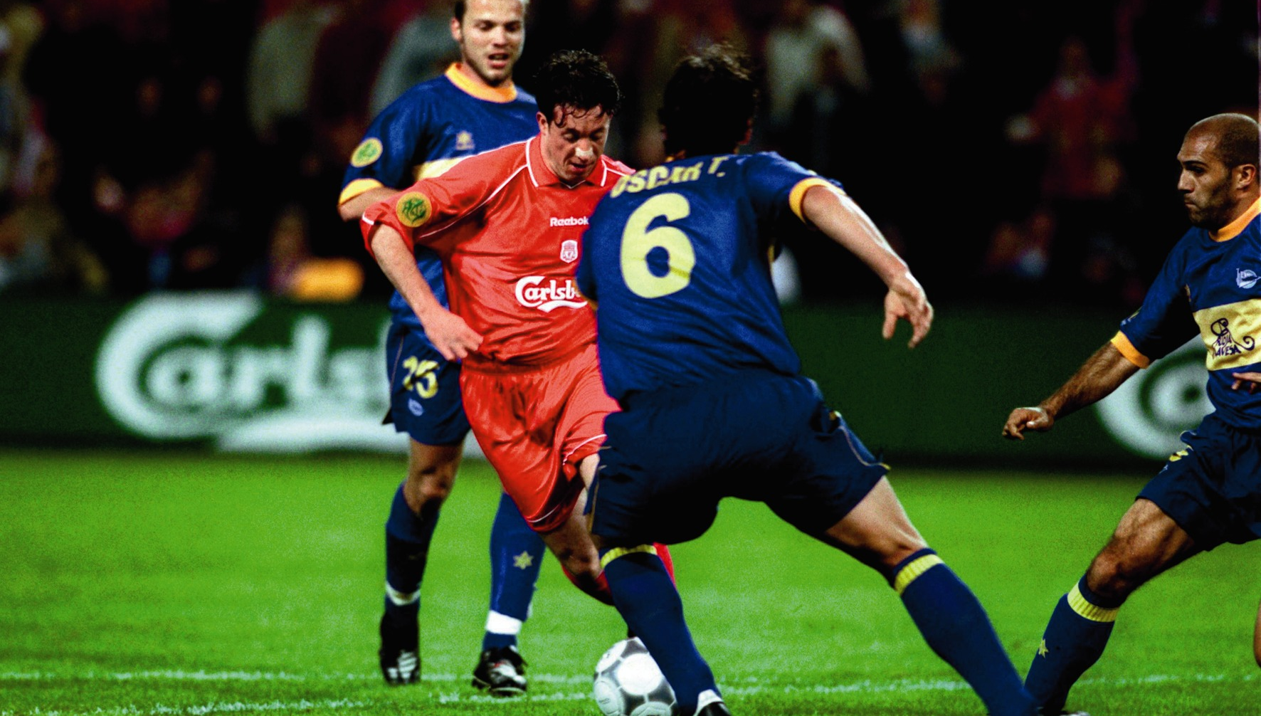
Decision

Slide 6
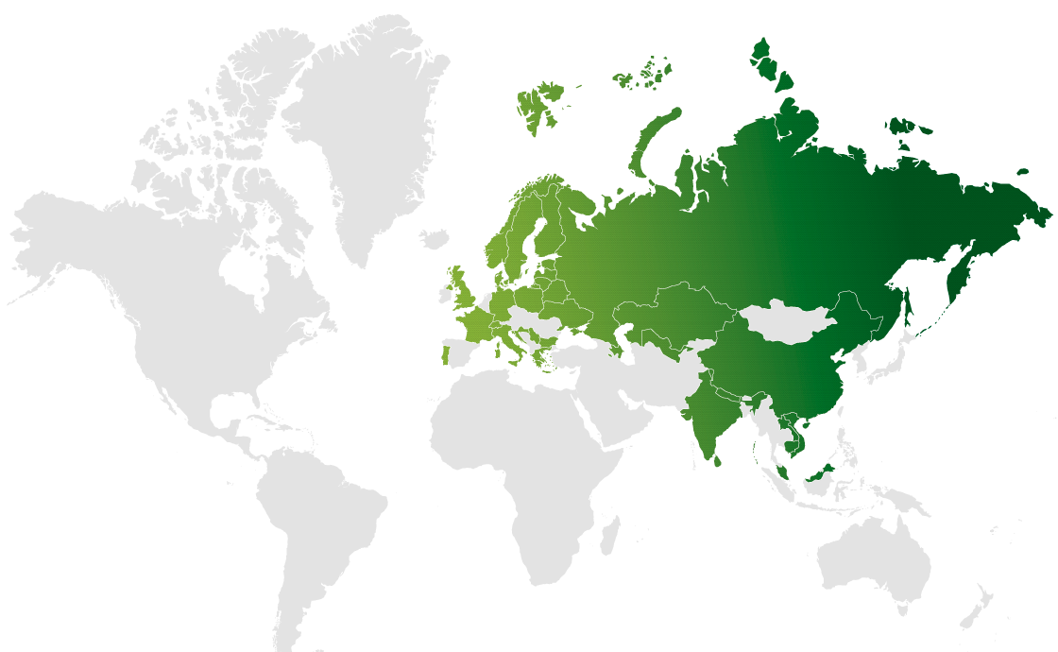









Beverage industry at a glance
  Mature markets with little growth
  Control markets and leverage scale benefits
  Most markets are already controlled
  Opportunities only in developing economies or urban areas
  Act quickly, anywhere

Slide 7

1990 – A small company with a big brand
In1990 Carlsberg was an international beer brand through export and licensed brewing.
MALAWI

Slide 8
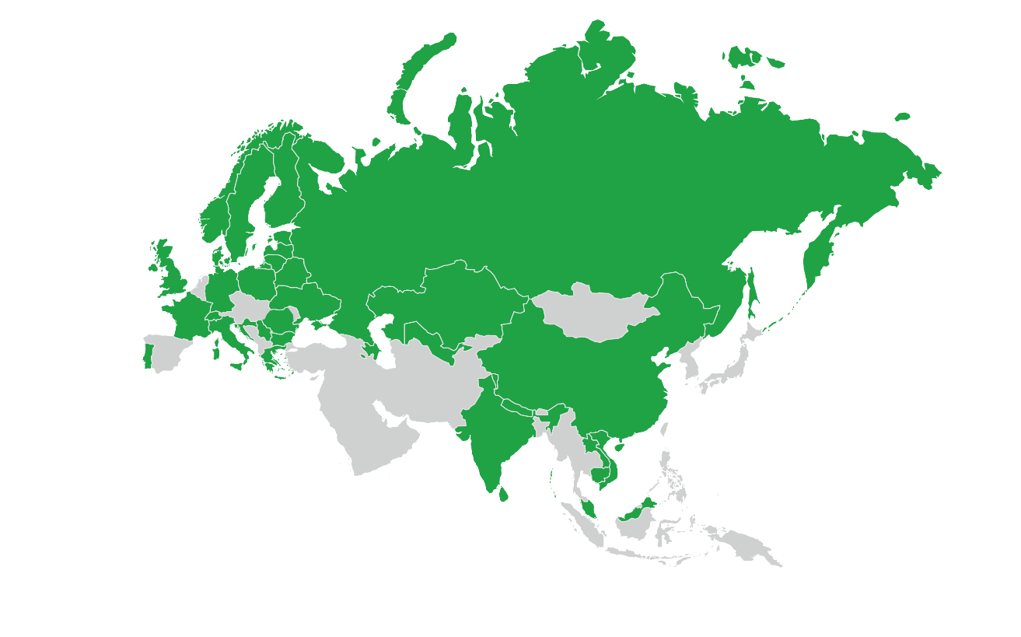

Today – Top 4 international brewer
31 markets
140 beer brands
no 1 in Eastern Europe
no 2 in Western Europe
47,000 employees in 2015
120.3 million hectoliters of beer sold in 2015

Slide 9
Our 2012 challenge
Need
Work as one global company. Yesterday.
Reality
17 separate infrastructures and IT organizations.

Slide 10
Options
Merge and build
Merge organizations and build global infrastructure.
Cheat
Deploy global cloud collaboration services without fixing the basics.

Slide 11
Decision
Merge and build
Merge organizations and build global infrastructure.
Cheat
Deploy global cloud collaboration services without fixing the basics.

Slide 12

Journey

Slide 13
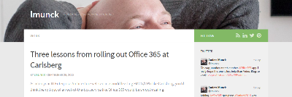
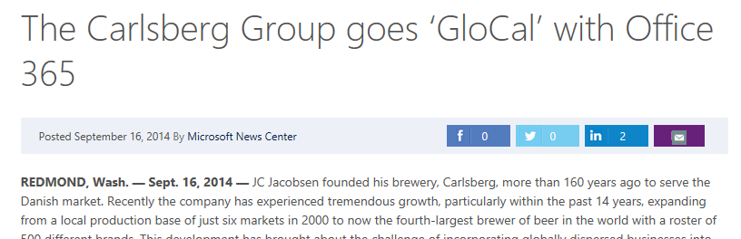
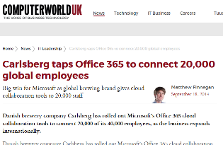
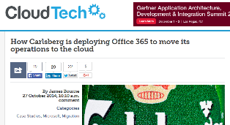
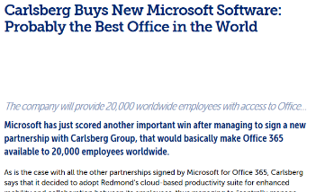
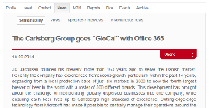
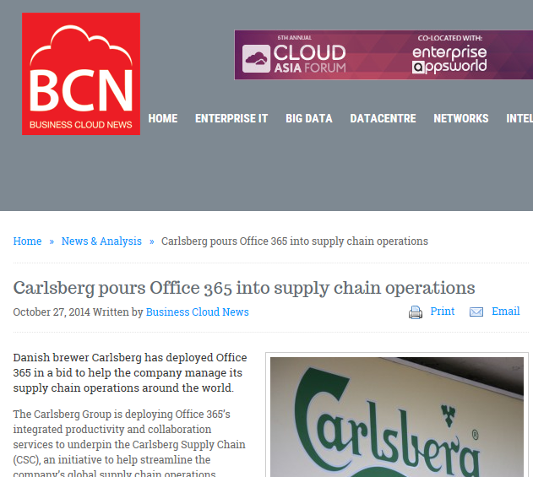
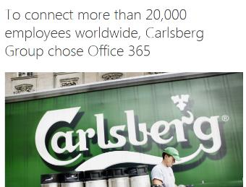
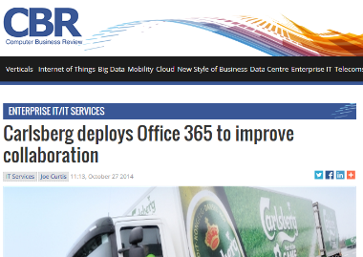
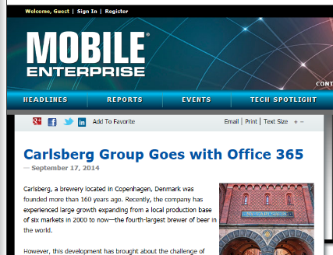
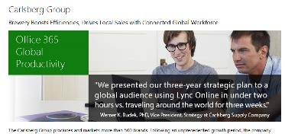
Office 365 project at a glance
Contract signed spring 2012
Three weeks later first market with 300 people migrated
Summer 2013 all markets in Europe and first markets in Asia (15.000 users).
Summer 2014 all markets in Asia (+4.000 users)
Summer 2015 all markets in Eastern Europe (+6.000 users)
~25.000 users in 2½ years

Slide 14








Experience
Security and Legal
Migration
Operations
Support
License mgmt.
Maintenance
Network
Adoption
  Few challenges
  Some challenges
  Significant challenges

Slide 15
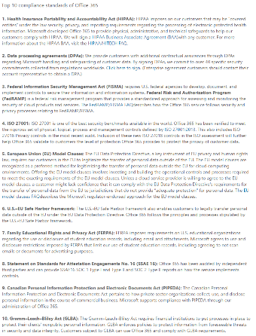
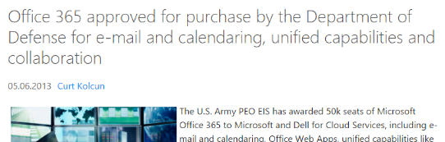
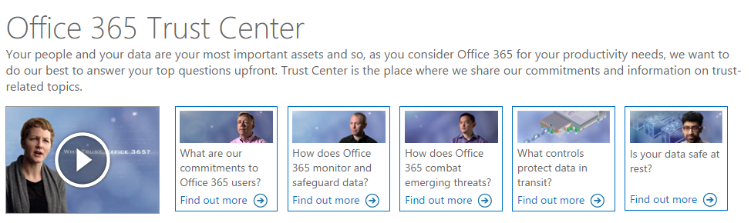
Security and Legal
Experience
Peer experiences – Concerns but no concrete risks identified
Trust Center – Better security certifications than our own data center
O365 DC audits – No comments by independent auditors
O365 technical design – End-to-end encryption on critical data and data centers within EU
Decisions
O365 will not increase risks
Approved by Security and Legal

Slide 16
Migration
Experience
Mature migration tools
Multiple fallback options: Cloud accounts, Outlook PST-files, etc.
Lots of help from Microsoft
Decisions
Three migrations – Western Europe, Eastern Europe, and Asia
Two migration models – Exchange migration or PST-file copy

Slide 17
Operations
Experience
Stable environment
Simple responsibility split -> We put the accounts/data in the cloud, and MS operates it
Main source of issues was our own inexperience with operating cloud services -> On-premise AD changes impacting cloud
Microsoft was crucial in fixing issues and reaching stable operations. Particularly with our very complex infrastructure.
Decisions
Two operating models – Cloud accounts, Integrated accounts

Slide 18
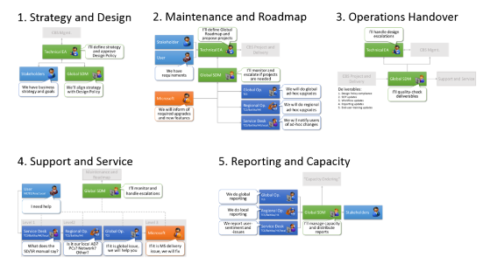
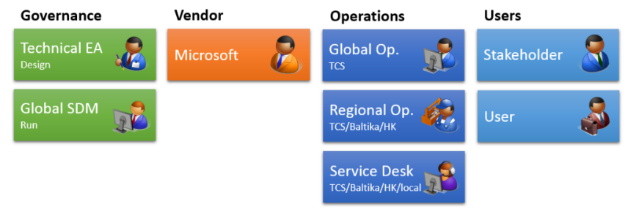
Support
Experience
We had no global service desk, no global incident management, no history of operating across regions
We managed just fine although it did take some quick decisions.
Decisions
Leveraged as-is processes in each markets
Implemented global role-names and added two global roles: Global SDM and Global Operations (TCS)
Designed very simple workflows

Slide 19
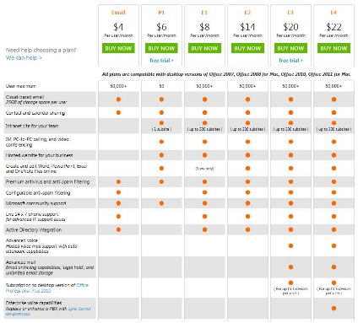
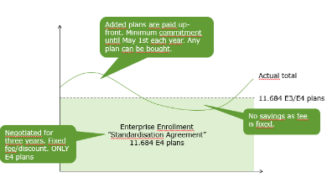
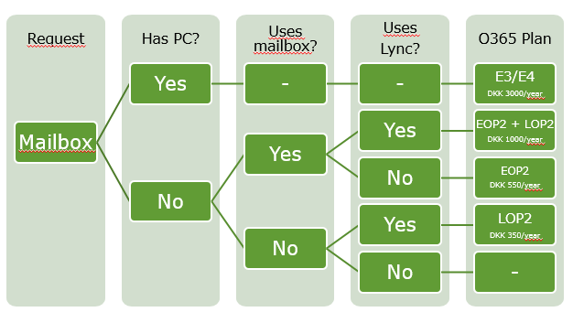
License management
Experience
Unclear license rules – Qualified user/device
Changing license rules – New plan details every year
Licenses not fitting real world – Shared department accounts, meeting rooms with active accounts
Decisions
We have to do a LOT of license training (incl. of MS own people)
We have to be creative and triple-check individual cases with MS licensing

Slide 20
Maintenance
Experience
Things get better – Groups, SPO libraries, SharePoint overview, Delve
Things get worse – Blogs disappeared, “sway pages” launched before ready, Akamai IP ranges keep changing.
Roadmap is clearer, but not entirely clear – Roadmap site, service status site, but very difficult to make detailed impact analysis of each change.
Support is great – We’ve had a LOT of direct collaboration with Microsoft.
Monitoring is not good, but getting better – The new reporting is better, but doesn’t allow any drilling into data, root causes, or behaviors.
Decisions
We purchased separate reporting platform based on Cogmotive
We’ve postponed adoption activities of key features due to uncertainty about what they will look like in future.

Slide 21
Network
Experience
Our networks were not ready for Office 365/cloud – Hub’n’spoke, minimal bandwidth, IP-based firewall rules
O365 services difficult to manage – Very difficult to separate internal traffic, inconsistent “Excel traffic calculators” per service
ExpressRoute is too expensive for general use
Skype is very susceptible to network issues and impossible to use in some locations.
SharePoint intranet performance is difficult to achieve unless frontpages/news are Azure hosted.
Decisions
Upgrade firewalls, bandwidth, and a lot of other components.
Planning to move end-user devices outside internal network – Always on VPN
Volunteer to test ANY initiative that MS does to improve in this area
No roll-out of Skype in Asia, and EE still using hybrid.

Slide 22
Adoption
Experience
Exchange adoption is very easy – People don’t notice the difference
Skype adoption is somewhat easy – People complain about performance and complex UI (yes, still)
SharePoint/Yammer adoption requires a lot of work – Too many options, buttons, and overlapping functionality to give a simple message
New features aren’t invisible unless we promote them, and it’s difficult to to asses when they’re mature enough to promote - Delve, Planner, Blog, Video, etc.
Results
Adoption is very hard work and will never stop

Slide 23
Summary
It was less trouble than we thought
It has been much better than we expected
Without Microsoft as partner we couldn’t have done it
We would do it all again… and we are

Slide 24

Today

Slide 25
It’s no longer about technology
In only four years we’ve moved 25.000 people, across three continents, to one state-of-the-art collaboration platform.
Notes:
Sources:
GBS Office 365 roll-out.

Slide 26
We are getting great value every day
Every day we have almost 4000 Skype conferences,
and send 360.000 mails in Office 365.
Notes:
Sources:
Office 365 statistics 2012-2015 and file-server statistics 2010-2015.

Slide 27
But easy availability is not just a good thing
In 2016 Q1, we used over 700 different online tools for collaboration,
and 9% of these had significant security risks
Notes:
Sources:
SkyHigh analysis of network traffic in Q1 2016.

Slide 28
Todays workplace is noisy and cluttered
Every year we send 30% more mails, use 20% more file storage, and people are unsure what to use or where to find things.
Notes:
Sources:
Office 365 statistics 2012-2015 and file-server statistics 2010-2015.

Slide 29
And reduces the value of our investments
Top 10% of Skype users account for 80% of total usage,
top 10% of OneDrive users account for 97% of total usage,
and this pattern is similar for all global IT services.
Notes:
Sources:
Office 365 statistics from May 2016 retrieved via Cogmotive

Slide 30



Three challenges
Increasing demand
Backlog, new technology, changing market
Easier access
Online/portable apps, systems of innovation
Finite change-capacity
Generational gap, complexity, inertia
Notes:
A c

Slide 31



Forming a negative cycle
Increasing demand
Easier access
Finite change-capacity
Impact:
We don’t know what we have or how to use it
We don’t use what we’ve bought
We buy what we already have, adding to the confusion
Notes:
A c

Slide 32
How do we change that?

Slide 33

Change starts with people
Photo: Steve Wilson

Slide 34
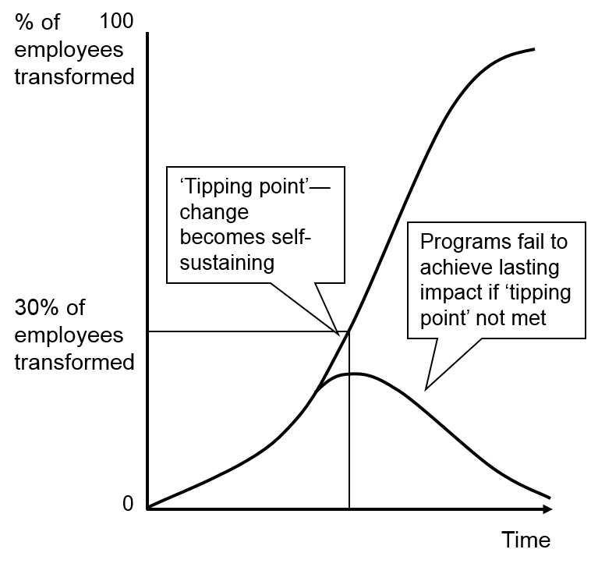

But change is not getting easier

Slide 35
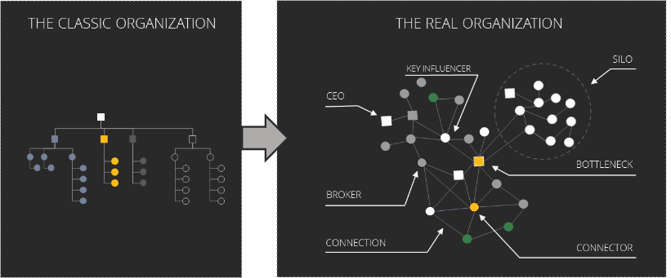
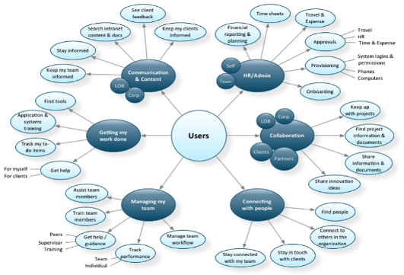

It requires deeper understanding
©

Slide 36
And more comprehensive execution
Workplace culture
Workplace collaboration
Personal computing
Workplace Resources
Agility
Differences
Stability
Standards

Slide 37















Great technology is no longer enough
Social
Skype and
telephony
Devices
and apps
Mail and
calendars
Identity and authentication
Team-work
and calendars
Facilities and
meeting-rooms
Documents
and file-sharing
Intranets
and websites

Slide 38
Working separately is no longer an option
Initiatives
Workplace culture
Personal computing
Workplace Resources
Workplace collaboration
Communications
?
Messages
Legal
Tools
Projects
HR
Standards
Policies
IT

Slide 39
We need a common story
!
Communications
One workplace
Change
Legal
HR
IT

Slide 40
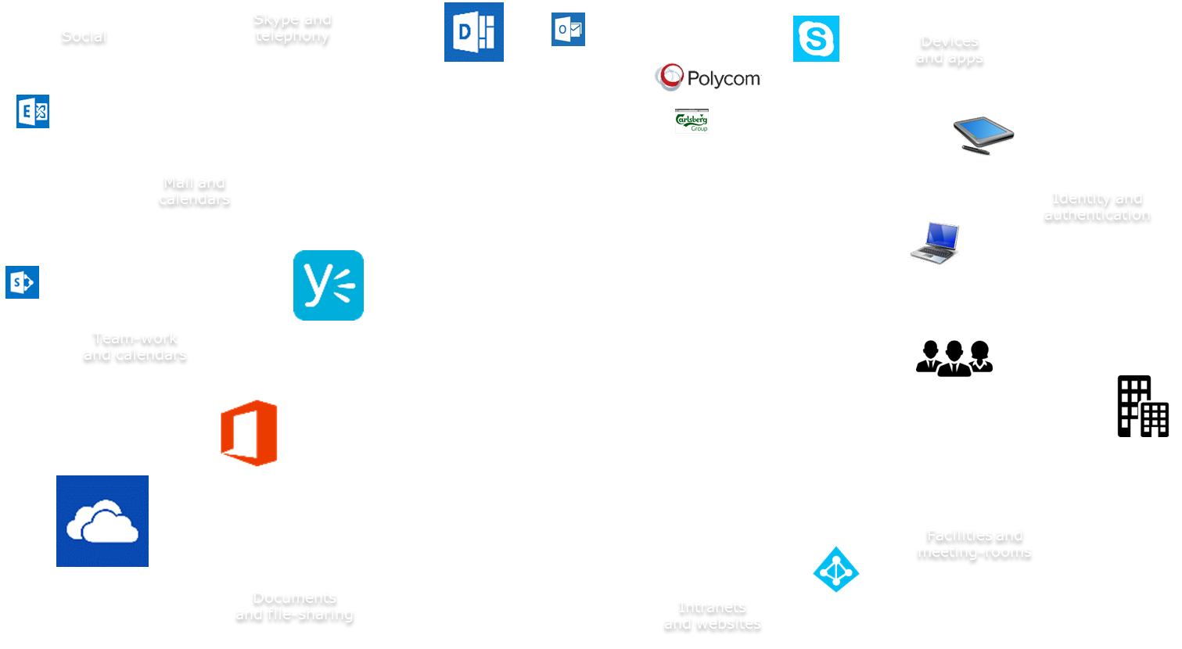
To turn great technology
Communications
One workplace
Change
Legal
HR
IT

Slide 41

Into a modern workplace
Workplace culture
Communications
Our workplace
Workplace collaboration
Personal computing
Change
Legal
HR
Workplace Resources
IT

Slide 42
Summary
A modern workplace requires new focus
Even great “Traditional IT” is no longer enough
Office 365 allows us to focus where it matters
Mobility/Cloud first is now a core strategy

Slide 43
Modern Workplace

Slide 44
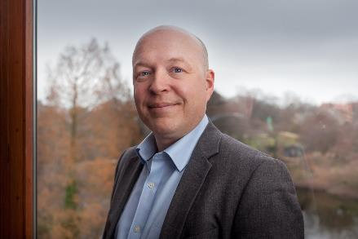
Sources:
Recipe for Digital Workplace Execution: Transform the Employee Experience
Creating a Digital Workplace Execution Strategy
Anders L. Munck
Workplace Enterprise Architect

Slide 45
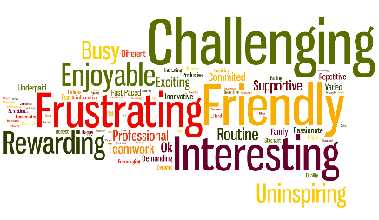
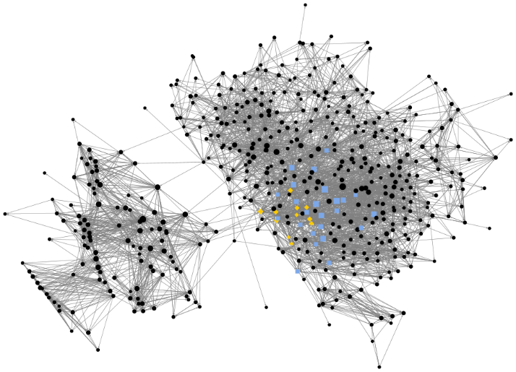
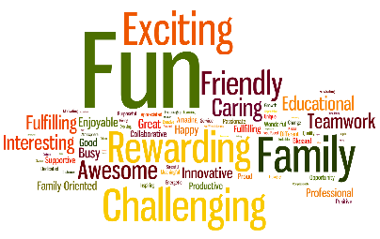
Identify what divides us
UNITED KINGDOM
TOP 10 WORDS
Challenging
Friendly
Frustrating
Interesting
Enjoyable
Rewarding
Busy
Uninspiring
Routine
Exciting
USA
TOP 10 WORDS
Fun
Family
Exciting
Challenging
Rewarding
Friendly
Awesome
Caring
Interesting
Teamwork
©
Notes:
Innovisor case:
US Company purchased UK company 2-3 years earlier, and wanted to investigate what joint culture had evolved.
They realized that almost none had, and that they needed to do something to avoid losing colleagues in UK

Slide 46
Identify what divides us
 | Standardization | Individuality
Agility | Workplace collaboration | Workplace culture
Stability | Workplace resources | Personal computing
Notes:
Innovisor case:
US Company purchased UK company 2-3 years earlier, and wanted to investigate what joint culture had evolved.
They realized that almost none had, and that they needed to do something to avoid losing colleagues in UK

Slide 47
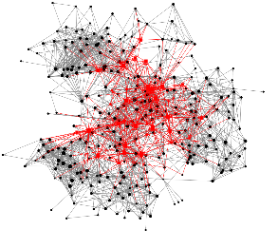
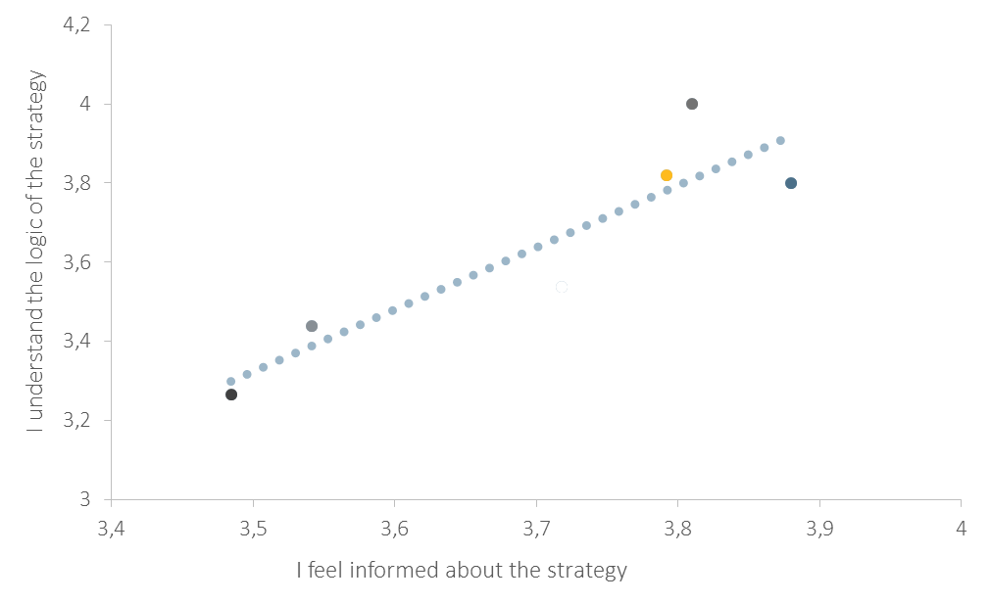
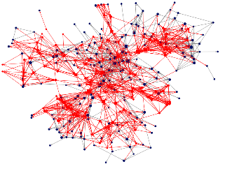
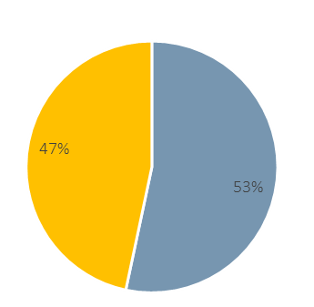
Focus where it matters
REACH OF MIDDLE MANAGEMENT
INFORMATION → UNDERSTANDING
THE REACH OF THE 10 EMPLOYEES
53% NEGATIVITY
The new top leadership did in fact have no vibe in the organization, which was less surprising than the lack of contact between middle management and the employees
This was more apparent in some departments than other. The less informed about the strategy the less the employees understood the logic behind the strategy
10 very influential employees enabled access to the majority large parts of the organization
These very influential employees were more negative and disengaged in the transformation than the average employee. 53% of the words they used to describe the organization were negative.
©
Notes:
Innovisor case:
The company engaged regularly in trusting conversations with the 10 influential employees. They listened and calibrated their messages.
Already after four months the overall engagement scores were up by 20%, and the negativity amongst the influential employees had been turned into advocacy for the transformation.
They were in fact regular transmission towers

Slide 48
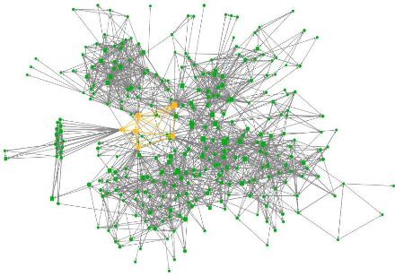
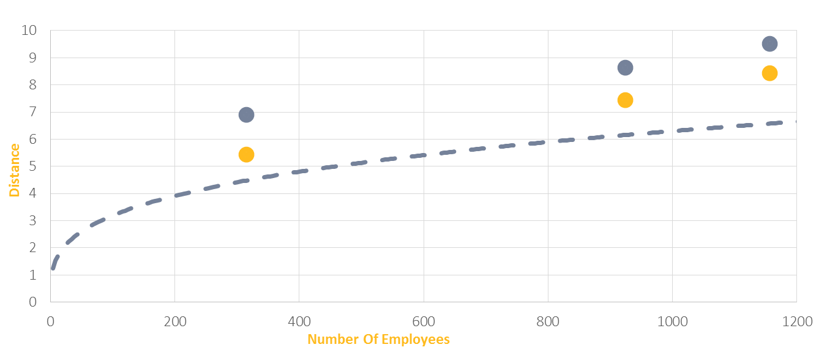
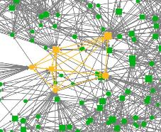
And design for change
20%
INSIGHTS
Simulation shows that connecting the right employees improves the agility.
Adam, Anesh, Carol, David, Lee, and Thomas are the short-cut to increased agility.
ACTION
Set up tasks, projects or focus-groups for the identified key connectors.
When they build relations to each other the average distance between all persons in the business unit decreases.
INSIGHTS
Organizational agility is improved by 20% - just by connecting the right six employees.
This is still not on-par with the Innovisor benchmark, so another 10% improvement needs to be identified
©
Notes:
Innovisor case:
Improving agility permanently by continuously identifying key influencers and involving them in changes from the early stages

Slide 49
It requires a much deeper understanding
THE CLASSIC ORGANIZATION
THE REAL ORGANIZATION
KEY INFLUENCER
SILO
CEO
BOTTLENECK
BROKER
CONNECTION
CONNECTOR
©

